Slide 1
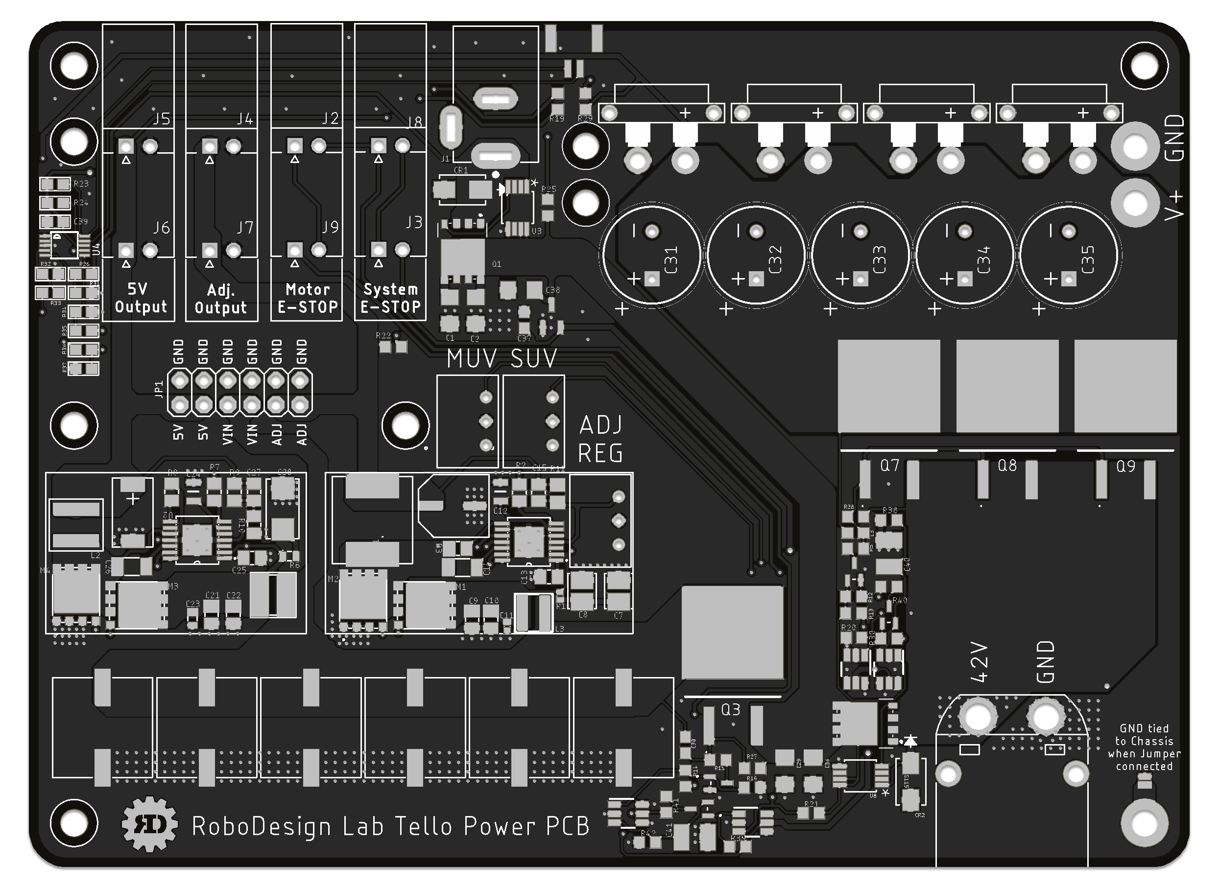
Tello Power PCB:
2x 5v output ports (6A total)
2x Adj. 0.6-40v output ports (6A total)
2x Motors only E-stop ports
2x Full system E-stop ports
Backup power input for hot swapping batteries
1x I2C ADC for computer to read voltages:
Battery voltage
Power Supply voltage
Adjustable Regulator voltage
Motor Voltage
4x XT30 Motor power ports
Optional Expansion for more motor ports
Optional Expansion for more reg. outputs
Adjustable under voltage cut-off to protect battery
Voltage has to be under threshold for 30 seconds before motors and system shuts off
Soft Start circuit powers on system and motors at safe speed
Optional Jumper to tie electrical GND to robot body
Capacitor banks to filter voltage dips due to motor current draw
(1)_{port}
(2)_{port}
(3)
(4)
(5)
(6)_{port}
(7)
(8)
(6)_{ADC}
(13)₂
(9)
(1)_{Regulator}
(2)_{Regulator}
(10)₂
(11)₂
(13)₁
(12)
(10)₁
(11)₁

